Slide 1
‘semntle’ AI challenge
Final Software engineering project

Slide 2

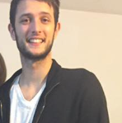

MEET OUR TEAM
Nes Afriat
Yuval Hitter
Bar Damri
Presentation & Programmer
CTO
Coordinator & Programmer

Slide 3
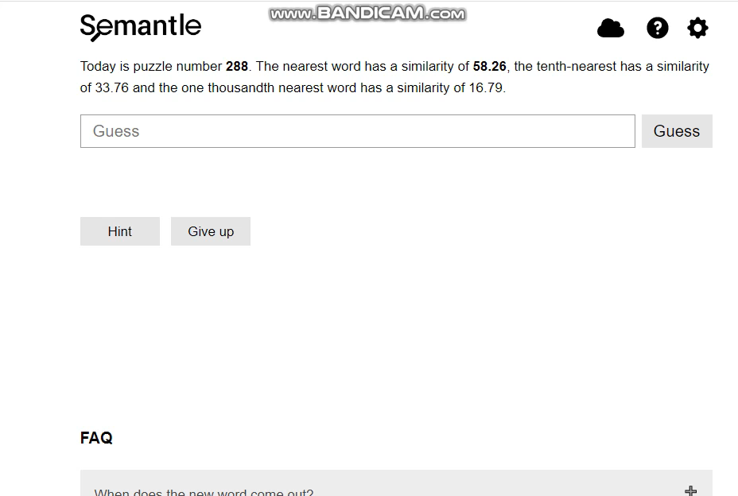
The problem domain
‘Semantle’ is a popular online words’ game.
1. The player guess in each turn the host secret random word.
2. As reply - he gets the semantic similarity score from the host.
3. The player can also get a ‘hint’ – a word which relatively close to the secret one.
And it’s a tough game!!

Slide 4


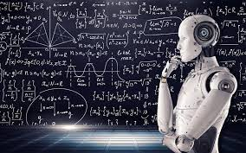
The challenge
We want our program to defeat the game by itself – in the minimum guesses possible!
But how?

Slide 5
Our solution – and field of research
Word Embedding
AI
one of the most popular representation of document vocabulary as vectors.
Artificial intelligence is the simulation of human intelligence processes by machines, especially computer systems

Slide 6


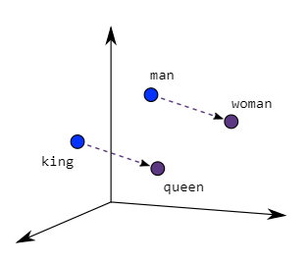

Why word embedding?
We need to somehow calculate the secret word – using the semantic distance
the host returns. Word embedding helps us to transform words & speeches
into vector representation while keeping knowledge about their context & semantics.
This way, we can use a trained semantic model as the area of knowledge for
our program – and to use it for calculations of ‘words’ as points in the space.
Why AI?
We want our program to gain information by guessing, process that information
And make better guesses until it finds the secret word.
Using various algorithms and the vector space of our semantic model we will improve our program guesses, by correcting their location in the vector space - until they will get to the exact location of the secret word!

Slide 7
Client
requirements

Slide 8

Functional & non-Functional requirements
PROCESS
 | Paperwork
 | Knowledge transfer request
 | Exit interview
 | Company Announcement
ACCOUNTS
 | Suspend email account
 | Redirect phone calls
 | Remove from Trello
 | Remove from Slack
LAST DAY
 | Send Resources
 | Remove from payroll
 | Send all finished projects
 | Request Feedback
 | Send a thank you letter
NEW CLIENT
 | Send initial invoice
 | Send welcome Packet
 | Schedule initial call
 | Connect on social channels
 | Send welcome gift

Slide 9
So, what’s our plan?
Strategy
Build an offline version of the game as research environment.
Establish communication with the ‘Semantle’ server.
Develop 3 different agents*, each with his unique state, And
Provide them guessing algorithms (Naïve and one or more
Sophisticated algorithms).
Running the agents and algorithms against the server, sample
Results (number of guesses, efficiency, speed, curve of guesses)
and produce conclusions and improvements.
Create a graphic user interface.
Document our research and pass hand it to the client.

Slide 10

our AGents
להסביר על הסוכנים
פיתרון נאיבי
מה זה טרילטלציה

Slide 11
Road map
Establish connection to the server and develop our agents
Research of agents results, optimizations and conclusions documentation
Develop our agents’ algorithms and test it offline and online
Comfortable and elegant user interface for users
Offline version of Semantle for the development
STEP 3
FUTURE STATE
Semester B
STEP 2
Semester A
-current state-
STEP 1

Slide 12


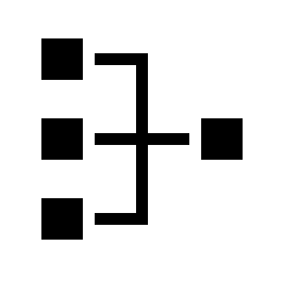


Technologies – API’S
‘Pygame’ API
https://www.pygame.org/docs/
Communication
‘requests’ library
https://pypi.org/project/requests/
Word embedding
‘Gensym’ library
https://radimrehurek.com/gensim/index.html
Algorithms
‘Numpy’, ‘scipy’, ‘tqdm’ libraries
‘Numpy’, ‘panda’ libraries
Design
Statistics

Slide 13

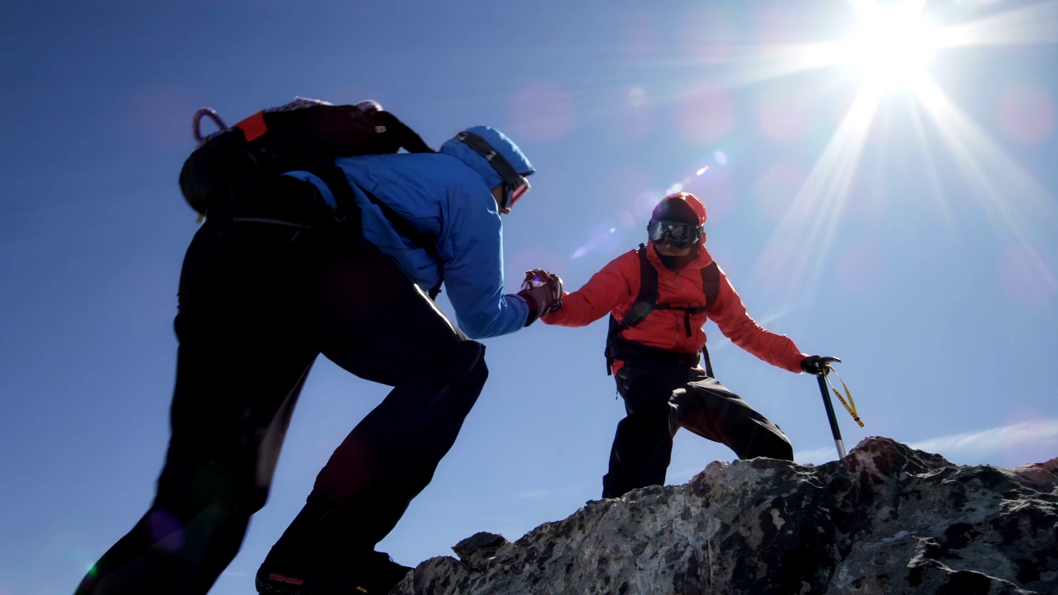
Challenges
Issue -
No experience with AI, Word embedding, nor academic research field at all!
Solution -
Google it!

Slide 14
THANK YOU
Questions?

